Slide 1

Social Media Crimes

Slide 2
TEAM MEMBERS
ROSHAN KUMAR GAMI
DHARMVEER SHARMA
SHANTANU SHASTRI
KUMAR SHIVAM
VAASUDEV KALA
VRINDA SHARMA
PRASANNA KUMAR DASH
PIYUSH GANGWAR
SATYENDRA KUMAR

Slide 3
Introduction
INDIANS ARE AMONG THE MOST ACTIVE ON SOCIAL MEDIA
SOCIAL NETWORKING SITES LIKE FACEBOOK, TWITTER , LINKEDIN,WHATSAPP ETC ARE BEING USED.
22% TIME IS SPENT ON SOCIAL NETWORK
TO BUILD COMMUNITIES OF PEOPLE WHO SHARE INTRESTS

Slide 4
Social Media Crimes
Cyber Terrorism/Weapons trade
Honey traps
Stalking
Defamation
Harassment
Cyber Bullying
419 Scams

Slide 5
Case studies
BACKGROUND
CASE OF GURUGRAM
CREATED FAKE FACEBOOK ACCOUNT OF A GIRL
USED HER PHOTO
UPLOAD PHOTO FROM ADULT WEBSITES
INVESTIGATION
COMPLAINT TO CYBER CRIME BRANCH GURUGRAM POLICE
FACEBOOK WAS APPROACHED
TRACED MOBILE NO.
CULPRIT IDENTIFIED

Slide 6
DISPOSAL & LEGALITIES
A MUTUAL COMPROMISE ARRIVED AT
OR
IT ACT 2000 SECTION 66C(Identity Theft) & 66D(Personation) APPLICABLE
SECTION 499 & 500 (DEFAMATION) OF IPC
PUNISHMENT
3 YEARS IMPRISONMENT/ 1 LAC OR BOTH

Slide 7
Intelligence Tools Developed

Slide 8
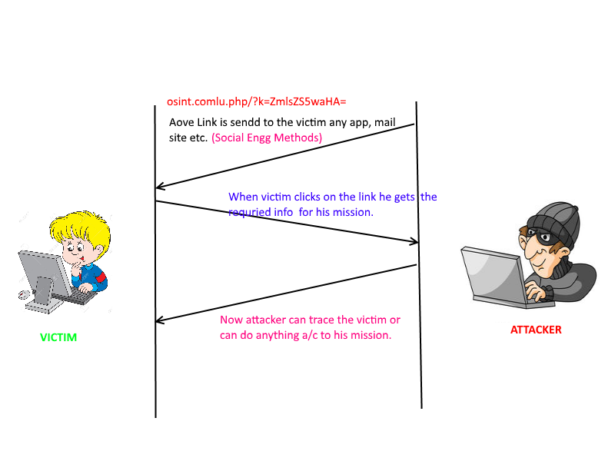

Slide 9
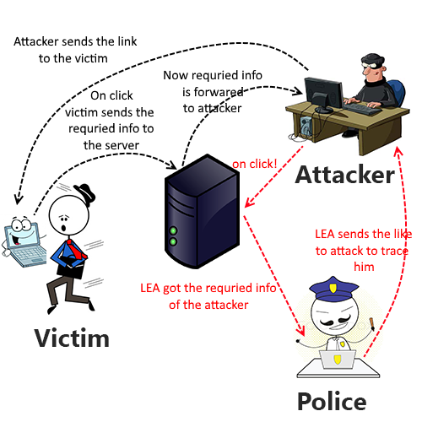

Slide 10
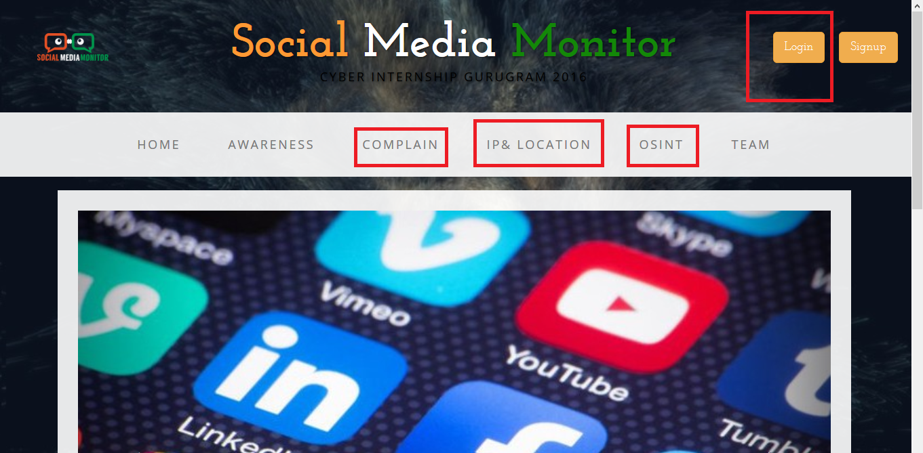

Slide 11
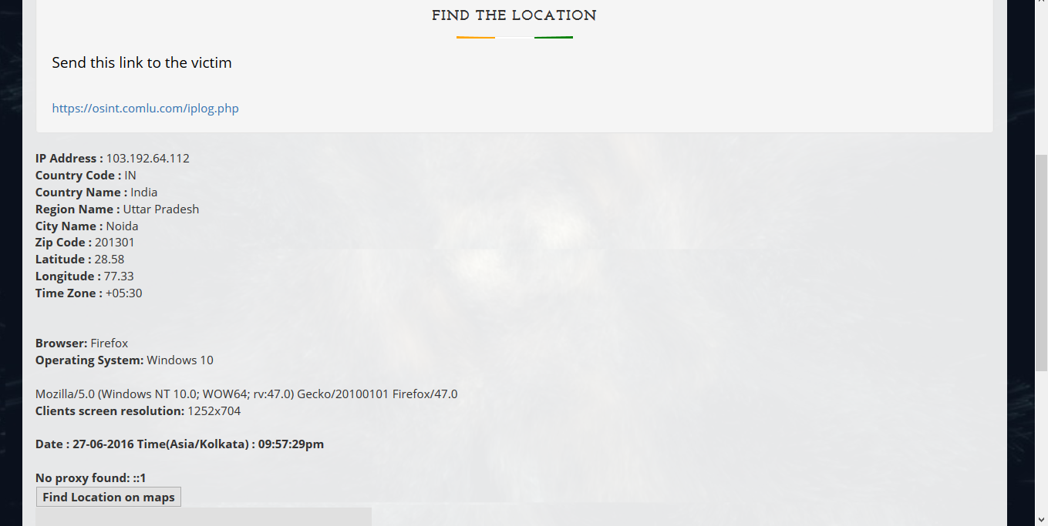

Slide 12
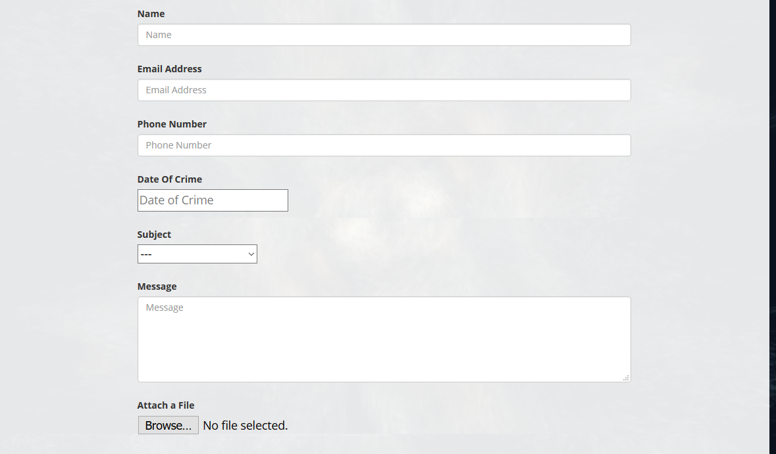

Slide 13
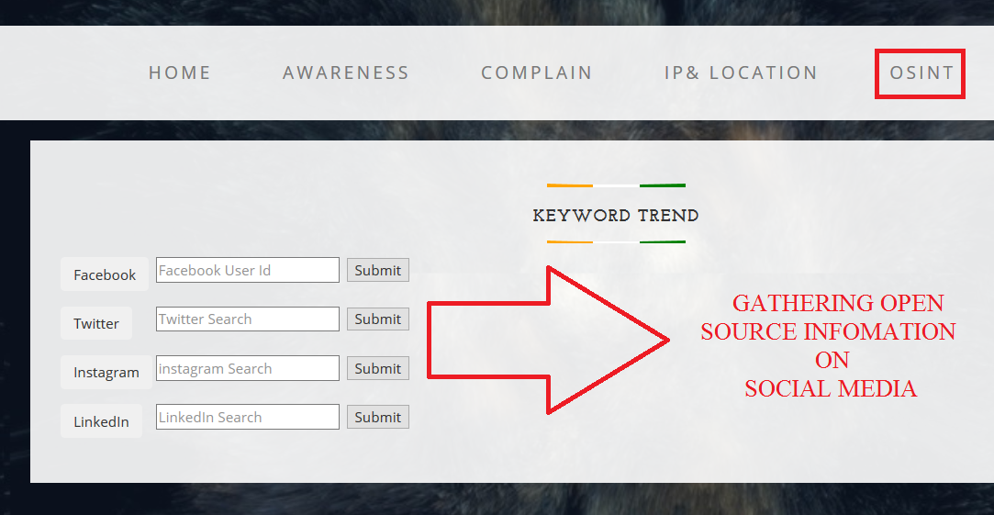

Slide 14
Any QUESTIONS?

